Slide 1
Financial Education in Schools:
Why Students Need to Learn the ABCs of Personal Finance
Annamaria Lusardi
(The George Washington University School of Business and GFLEC)

Slide 2
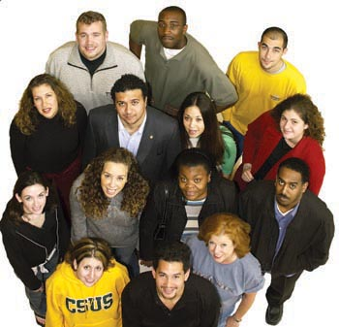
The Growing Importance of Financial Literacy
A New Economic Landscape
  Changes in labor markets
    More flexibility – workers change jobs often
    Divergence in wages – skills are critical
  Changes in financial markets
    Greater complexity of financial products
    More opportunities to invest and to borrow
  Changes in the education & pension system
    Higher cost of education/student loans
    More individual retirement accounts

Slide 3
Looking Forward
Increases in Life Expectancy Changes Everything
Título da Palestra
Nome do palestrante
Life expectancy is high, and has continued to grow globally.
Young people will confront a different economic system and require new skills.

Slide 4


Programme for International Student Assessment (PISA)
    Are students well prepared for future challenges? Can they analyze, reason and communicate effectively? Do they have the capacity to continue learning throughout life?
Título da Palestra
Nome do palestrante
    Since 2000, every three years the OECD Programme for International Student Assessment (PISA) answers these questions and more. It assesses to what extent students near the end of compulsory education have acquired some of the knowledge and skills essential for full participation in society.

Slide 5
Financial Literacy Assessment Starting in 2012
Measuring Financial Literacy Among the Young
  PISA is the first large-scale international study to assess the financial literacy of 15-year-old students
  18 countries participated in the 2012 Financial Literacy Assessment
  15 countries participated in the 2015 Financial Literacy Assessment
Título da Palestra
Nome do palestrante
  The countries/economies are:
  2012: Australia, Belgium (Flemish Community), Shanghai-China, Colombia, Croatia, Czech Republic, Estonia, France, Israel, Italy, Latvia, New Zealand, Poland, Russia, Slovak Republic, Slovenia, Spain, and the United States
  2015: Australia, Belgium (Flemish Community), Brazil, B-S-J-G (China), Chile, Canadian provinces, Italy, Lithuania, Netherlands, Peru, Poland, Russia, Slovak Republic, Spain, and the United States

Slide 6

PISA Financial Literacy Assessment
Designing the Assessment
A group of experts was put together by the OECD to design the 2012 module on financial literacy
They represented many countries and many stakeholders (treasury departments, central banks, regulators, practitioners, academics)
Experts worked on the assessment for for for about two years
Título da Palestra
Nome do palestrante

Slide 7
PISA Financial Literacy Assessment
Definition of Financial Literacy
  “Financial literacy is knowledge and understanding of financial concepts and risks, and the skills, motivation and confidence to apply such knowledge and understanding in order to make effective decisions across a range of financial contexts, to improve the financial well-being of individuals and society, and to enable participation in economic life.”
Título da Palestra
Nome do palestrante

Slide 8
Four Key Aspects of the Financial Literacy Definition
There are 4 innovative aspects of this definition that can be highlighted:
1. Financial literacy does not refer only to knowledge and understanding, but also to promote effective decision making
2. The objective of financial literacy is to improve financial well-being, not to affect a single behavior
3. Financial literacy has effects not just for individuals but for society as well
4. Financial literacy, like reading, writing, and knowledge of science, enables young people to fully participate in economic life

Slide 9

A Short Definition
Financial Literacy: A Vision for the Future
  Financial literacy is about the future
  It is essential to have a vision for the future
  3. The final objective of financial literacy is individual well-being

Slide 10
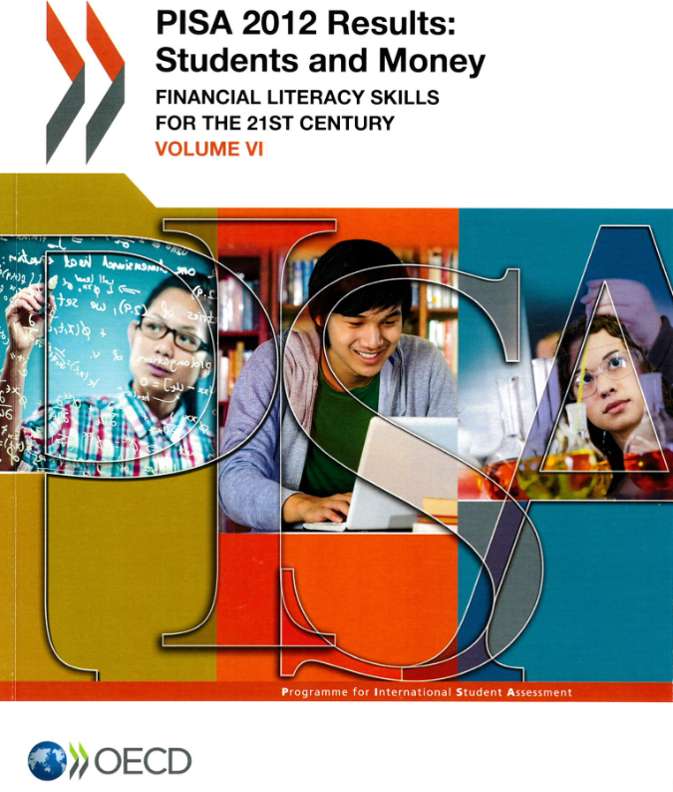
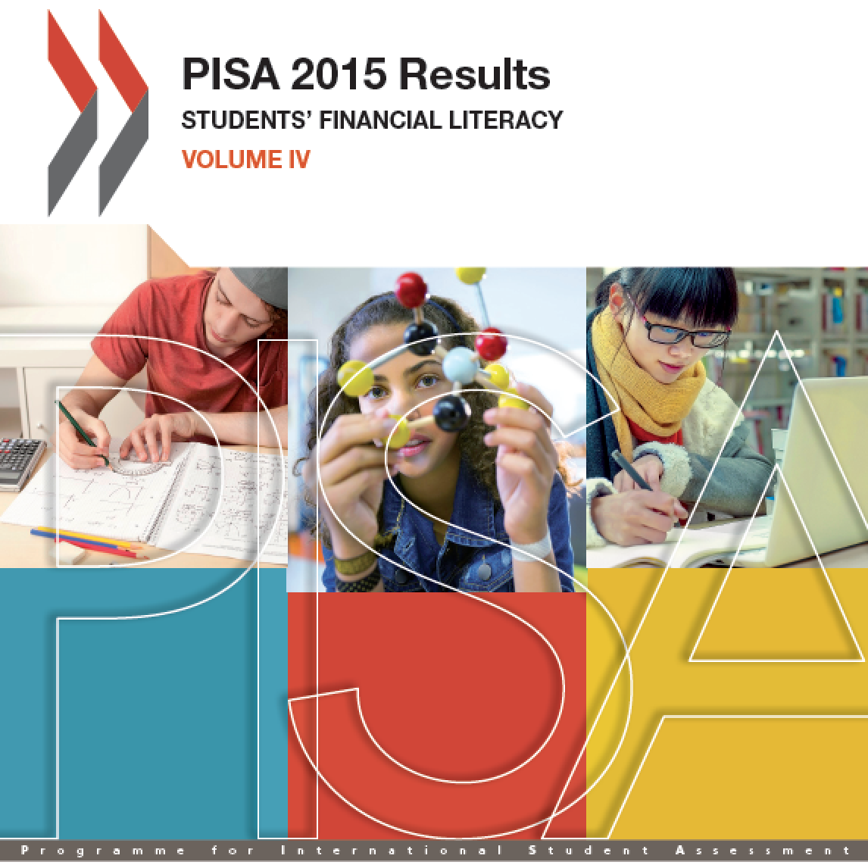
Financial Literacy Skills for the 21st Century

Slide 11
Strong performance in
financial literacy
Average performance
of 15-year-olds in financial literacy in 2012 PISA
Low performance in financial literacy
Notes:
This chart illustrates the financial literacy scale, from below the OECD average, marked in red, to around the OECD average, marked in yellow, to high performance, marked in green

Slide 12
Real GDP Per Capita and Financial Literacy (2012)
GDP per capita only explains 16% of country level variations in financial literacy (in 2012 PISA)

Slide 13
Strong performance in
financial literacy
Average performance
of 15-year-olds in financial literacy in 2015 PISA
Low performance in financial literacy
Notes:
This chart illustrates the financial literacy scale, from below the OECD average, marked in red, to around the OECD average, marked in yellow, to high performance, marked in green

Slide 14
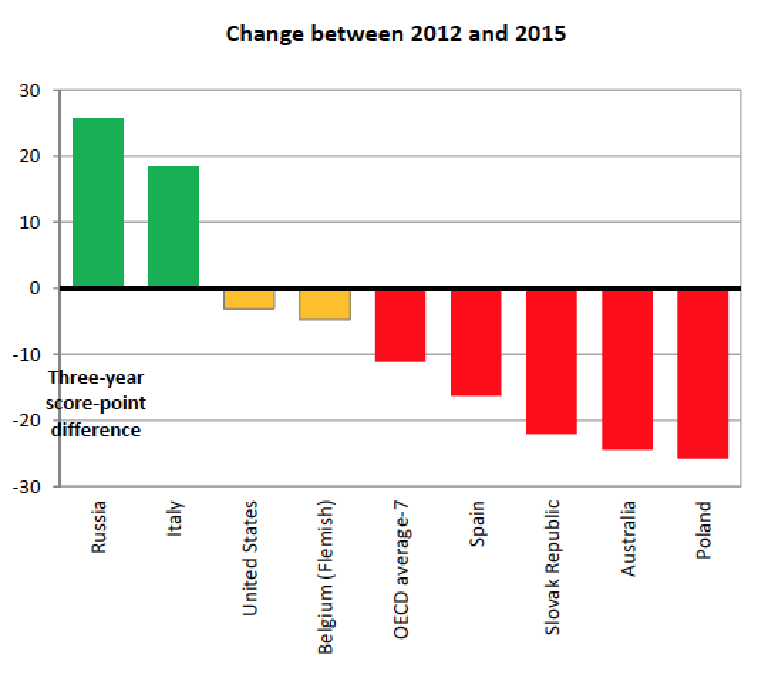
Improvement & Decline in Financial Literacy Over Time

Slide 15
Scores and Proficiency Levels
The difficulty of test questions was estimated based on the proportion of students answering each question correctly
The proficiency of students was estimated using the proportion of test questions they answered correctly
The relationship between the difficulty of questions and the proficiency of students was presented on a scale divided into five levels:
    Level 1 indicates low proficiency
    Level 2 indicates baseline proficiency
    Level 3 indicates intermediate proficiency
    Levels 4 and 5 indicate high proficiency

Slide 16
Many Students Lack Basic Financial Skills (2015 Data)
22%
On average across OECD countries and economies, 22% of students do not have basic financial skills (level 1)
In the US, 22% of students do not have basic skills

Slide 17
Few Students Have Advanced Knowledge (2015 Data)
Only about 12% of students across participating OECD countries and economies are top performers (level 5).
In the US, 10% of students are top performers.
12%

Slide 18
Young People are Already Financial Consumers
Some 56% of 15-year-olds in participating OECD countries and economies have a bank account, 19% have a prepaid debit card
56%
64%
Some 64% earn money from some type of work activity
31%
But fewer than one in three students have the skills to manage a bank account

Slide 19
Large Variation Within Countries (2015 PISA Data)
Variation within each country is wider than the variation between countries at the mean
Percentage of students at various percentiles on the financial literacy scale
Título da Palestra
Nome do palestrante
Score-point difference between 90th and 10th

Slide 20
The Role of Socioeconomic Status (PISA, 2012)
Young people who are financially literate are from educated families who have a lot of resources.

Slide 21
Role of Parents and Socio-Economic Background
(2015 Data)
84%
On average, 84% of students discuss money matters with their parents at least once a month
Students who do so tend to perform better in financial literacy
But financial skills are strongly related to the socio-economic background of their family
Advantaged students score 89 points higher in financial literacy than disadvantaged students
89 score points

Slide 22
The Role of Socioeconomic Status (2015)
Mean score, by quarters of the PISA index of economic, social and cultural status (ESCS)
Socioeconomically advantaged students score 89 points higher than disadvantaged students, on average across OECD, this is equivalent to more than one PISA proficiency level.

Slide 23
Making The Case for Financial Education
PISA data reveal that 38% of the variation in financial literacy is not explained by mathematics and reading skills
Many features of financial literacy are unique to the subject
38%

Slide 24
The Economic Impact of Financial Literacy
Financial education provided as early as upper elementary school demonstrates a measurable impact, with students experiencing sustained knowledge gains over time. Behaviors and attitudes related to spending, saving, and banking also improve (Batty, Collins & Odders-White, 2014).
Students in states that require financial education in school display better debt behavior (Brown, Collins, Schmeiser, & Urban, 2015)

Slide 25
Standards and training
Importance of rigorous curricula and trained teachers
      When exposed to rigorous curricula and trained teachers, students do well and are less likely to have problems with debt.
        Brown, Collins, Schmeiser, and Urban (2014). State Mandated Financial Education and the Credit Behavior of Young Adults.
    Confirms findings from previous work.
        Tennyson and Chau (2001) State Curriculum Mandates and Student Knowledge of Personal Finance. Journal of Consumer Affairs 35 (2), 241-262.
        Walstad, Rebeck and MacDonald (2010), The Effects of Financial Education on the Financial Knowledge of High School Students. Journal of Consumer Affairs 44(2), 336–357.

Slide 26
Conflicting evidence? Not Anymore
Learning from Meta-analyses
    Fernandes, Lynch and Netemeyer (2014). Financial Literacy, Financial Education, and Downstream Financial Behaviors.
      Interventions to improve financial literacy explain only 0.1% of the variance in financial behaviors
    Kaiser and Menkhoff (2016). Does Financial Education Impact Financial Behavior, and if So, When?
      Financial education is found to be effective
      Previous meta-analyses did not cover many and recent papers
      Take into consideration heterogeneity in estimates

Slide 27
The Cost of Ignorance (Lusardi and Mitchell, JEL, 2014)
Financial Illiteracy is Expensive
    Borrowing behavior
      Defaults and inability to pay
    Saving behavior
      Not saving enough for the short and long term
    Poor investment
      In financial assets, education, entrepreneurship

Slide 28
Implications for Financial Education
The Need for Financial Education
    Need to improve levels of financial literacy
      Levels of knowledge are critically low globally
    The young have very low financial knowledge
      Even in countries with advanced financial markets
    It is important to provide access to all
      Socioeconomic status is a strong determinant of financial literacy

Slide 29
Implications for Financial Education (cont’d)
The need for financial education
    We need to start in school
      Widespread financial illiteracy requires robust interventions
    Personal finance in college and beyond
      Many consequential financial decisions

Slide 30
Financial Education in School
What is Needed
  Need to train the teachers
  Rigorous curriculum
  Shift the focus from “Is it effective?” to “How do we make effective?”
  Start early

Slide 31
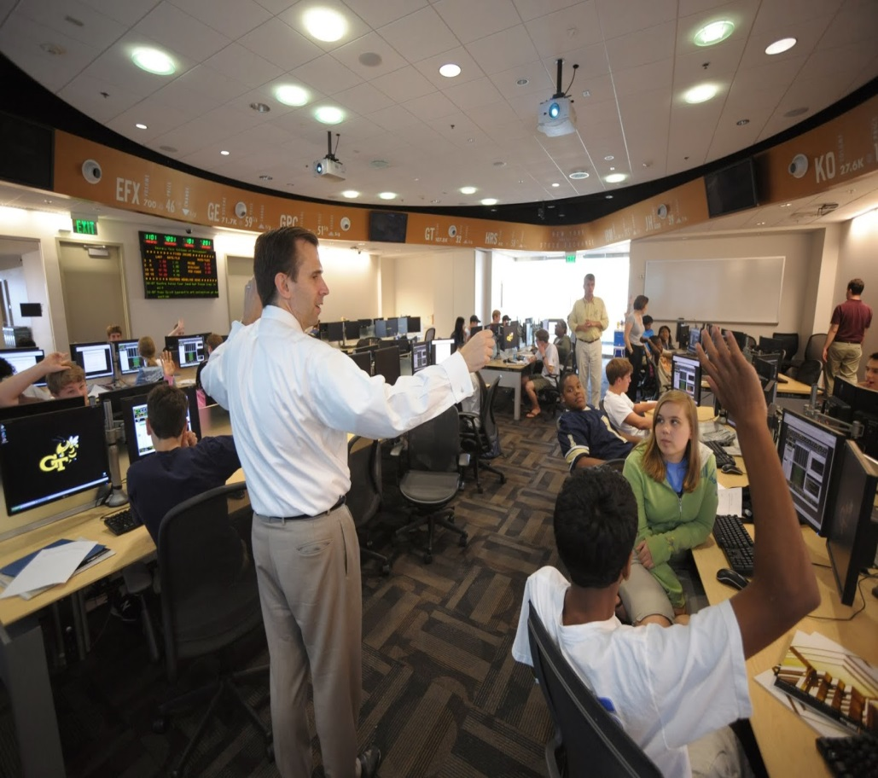
Out of School Initiatives
Videos, competitions, interactive tools, events (money weeks, savings day), museums, games
  May complement school initiatives
  Can reach those not enrolled in school
  Participation of non-profits and private sector

Slide 32


GFLEC’s Programs for Schools
A pilot program to train high school educators teaching financial education
  Program in collaboration with Digital Promise
  Goal: enable educators to strengthen their pedagogy and better use personal finance professional development resources
    A Personal Finance course at the George Washington University
  Using a rigorous quantitative approach
  Incorporating National Standards for Financial Literacy

Slide 33
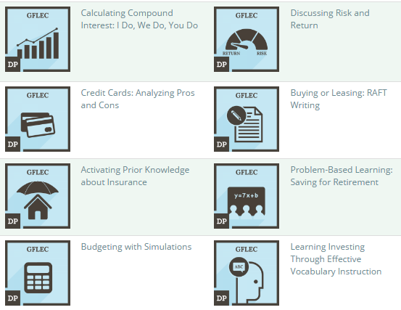
Financial Educator Micro-credentials

Slide 34
New Course: Personal Finance
A new course at the George Washington University
Financial Decision-Making: Implications for the Consumer and the Professional
  Cover personal finance with a rigorous approach
    A quantitative approach to personal finance
  Writing a textbook on personal finance
    Personal Finance for the 21st Century

Slide 35

What Can You Do To Help?
Promote the adoption of financial education standards in your state
Advocate for teacher training opportunities in financial education

Slide 36
Final Thoughts
  Financial literacy is like reading and writing
    As it was not possible in the past to participate in society without being able to read and write, so it is not possible to thrive in today’s society without being financially literate
  Building human capital for the 21st century
    Everyone deals with finance and finance is sufficiently complex that we cannot leave it to the individual to learn by himself/herself

Slide 37
Final thoughts continued
  Which future do we want to build?

Slide 38
Financial literacy: The best line of defense
  “Well-informed consumers, who can serve as their own advocates, are one of the best lines of defense against the proliferation of financial products and services that are unsuitable, unnecessarily costly, or abusive.”
  — Ben Bernanke, Former Fed Chairman

Slide 39
Thank you !
Resources are available on our webiste at www.gflec.org

